Slide 1
Rights & Transparency in AI voice-over case
Joachim Francois, AKQA

Slide 2
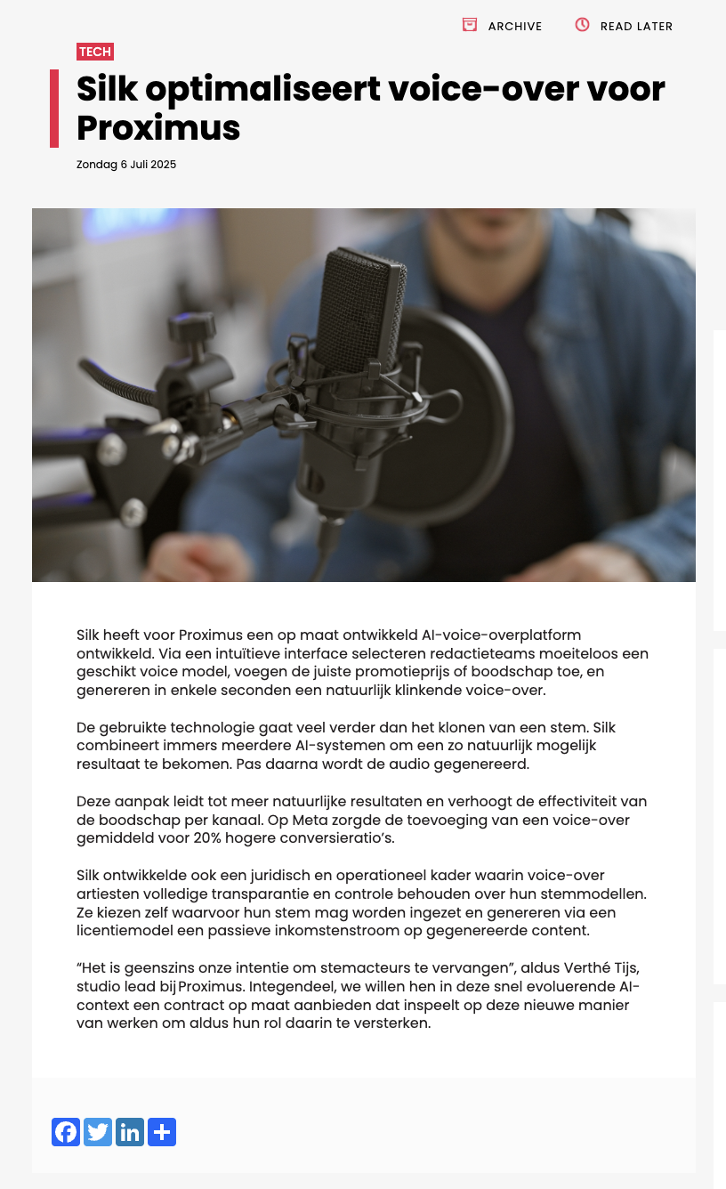
Proximus and AKQA launched a next-gen voice-over engine, powered by custom AI and built for performance at scale.

Slide 3

The tool combines professional voice cloning, smart scripting via GPT, and full legal transparency - transforming how multilingual VO content is created, used, and monetized.

Slide 4

Use-case goal
Augment our paid performance layer with voice-over to create more impact at scale.

Slide 5
The Agency/Client Workflow
POC
Test prototype within the
agency and key Proximus
innovation contact.
MVP
Use the POC with
key Proximus team of 6 people testing 10 assets.
LIVE
Insource and educate tool
within the marketing and
studio team.

Slide 6
The use-case process
Shortlist tool & VO
Test & choose tool
Voice creation
Produce assets
A/B test
Learnings & workflow
Top 3 cloning/synthesizing tools.
Our tool of choice
A commercial licensed ownable PXS voice
An A.I. voice added to 10 existing social performance assets
Comparing the ROI of both assets
Create case & make our voice scalable

Slide 7
Legal Framework
LOI & Consent with VO’s
Usage Scope
IP rights and fair compensation
Transparency
Include talent in POC
Define a clear scope
Setup rights framework
1 clear usage doc per month

Slide 8

Fails and Challenges
FR
Numbers
Prices
Proximus.be
70’s and 90’s are still pronounced
the French way.
(ie: Soixante dix)
Prices with commas are pronounced with the word « Centimes »
Not consistently pronouncing correctly the « point » « B » « E »
NL
Numbers
Prices
Proximus.be
“Negenennegentig” is not properly pronounced.
Prices with commas are often pronounced with the word « cents »
The domain name of Proximus is pronounced wrong in Dutch as well

Slide 9
Results
90% reduced production time
20% increased conversion rate
200% increased engagement

Slide 10
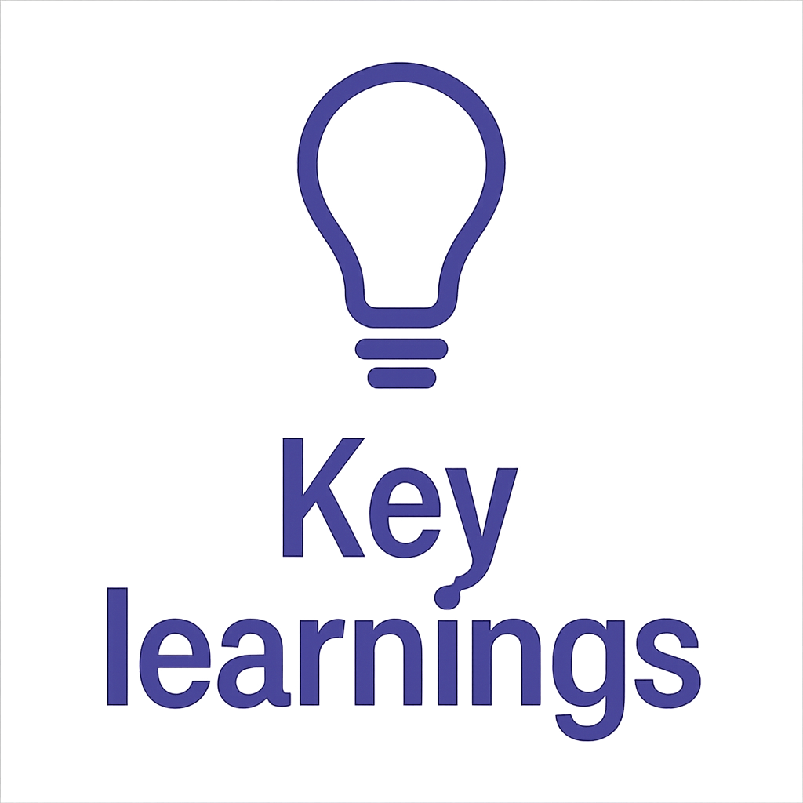
Research your tools ifo compliancy
Integrate talents in your pilots, budget scope and use-cases
Be 100% transparant in the usage

